Slide 1
Financial Assessment and Risk Monitoring (FARM) of Independent Institutions:
Year 1 Review
Board of Higher Education Meeting, June 22, 2021

Slide 2
Overview: MA FARM Law
Private, Independent IHEs
All MA-based, private IHEs located in MA and authorized to grant degrees must be annually screened and assessed to determine whether they are “at risk of imminent closure.”
BHE must establish process to conduct these annual financial screenings and assessments for “at risk of imminent closure” determinations
    Financial screenings may be conducted by accrediting agency (NECHE), pursuant to an MOU
IHEs must:
  proactively notify BHE of any “known financial liabilities or risks” .
  annually post audited financial statements
  ensure their trustees receive instruction and training, at least once every four years, on fiduciary duty and financial metrics

Slide 3
Timeline Overview
Financial Assistance and Risk Monitoring (FARM) Implementation
  June 2018-January 2019: THESIS recommendations; BHE accepts report (BHE 19-04)
  June 18, 2019: BHE Vote to put draft regulations out for formal public comment (BHE 19-06)
  November 14, 2019: Legislation enacted and signed
  November- December 2019: DHE staff revise regulations
  January 10, 2020: BHE Vote on final regulations (BHE 20-03); ongoing NECHE MOU negotiations
  April 8, 2020: BHE Vote related to implementation (NECHE MOU and Implementation Procedures); immediate implementation
  April 2020- June 2021: Year 1 Implementation
    (see next slides): Operationalizing policies and procedures, screenings and assessments, review of risk mitigation plans, contingency closure planning, trustee training, etc.
  June 22, 2021 BHE Meeting-Year 1 Review or “After Action Report”

Slide 4
Agenda
Year 1 Implementation
  Operationalized Business Processes- Dena
  Screening and Assessments- Tom
  Risk Mitigation Review and Monitoring- Tom
  Contingency Closure Planning- Pat
  Other requirements, IHE Reporting Portal –Dena
Recommendations, Next Steps

Slide 5
Operationalizing FARM: Internal Business Processes
Year 1 FARM Implementation
Process Managed by Cross-functional Regulatory Ream
  Legal- notice drafting; project management; external communications/tech assistance
  ANF- financial screenings and assessments; risk mitigation review/ monitoring
  Academic Affairs- contingency closure planning; risk mitigation review/ monitoring
  ALL- team members met weekly, participated in all phases of processes/ deliberations
Established external & internal communication protocols; templates; data trackers; IHE reporting portal; website
Adapted financial screening workbooks; created risk mitigation assessment summaries for Commissioner approval
Established and Convened Commissioner’s Advisory Committee
  Quarterly and as needed touchpoints

Slide 6
Year 1 Timeline Overview
April 26/27, 2020
DHE received FY19 screening results for NECHE institutions (610 CMR 13.03(1)(a))
June 12, 2020
DHE sent “you have screened in” letters to NECHE institutions (610 CMR 13.03(1)(c))
July – September 2020
DHE discussed financial screening results with NECHE institutions
August 2020
DHE screened non-NECHE institutions (610 CMR 13.03(1)(a); 610 CMR 13.03(1)(c))
October 2020
DHE sent “further action needed” letters notifying institutions they “may be at risk of imminent closure”- Risk Mitigation Plans requested and Phase 1 Contingency Closure (610 CMR 13.03(2))
May 2020 Advisory Committee Touchpoint-Orientation
September 2020 Advisory Committee Touchpoint- screening results

Slide 7
Year 1 Timeline Overview
November 2020
DHE sent “no further action needed” letters to remaining screened-in institutions (610 CMR 13.03(2))
December 23, 2020
DHE sent “moving to monitoring” letters to screened-in institutions (610 CMR 13.03(2)(b)(1))
March – June 2021
Ongoing review of institutional risk monitoring quarterly reports (610 CMR 13.03(3))
May 2021
NECHE transmission of FY20 screening results to DHE (610 CMR 13.03(1)(a))
November 2020 Advisory Committee Touchpoint
Spring 2021
Advisory Committee Touchpoint

Slide 8
FARM Process- Summary Slide
  Screenings and Assessments,
    Phase 1- received screening results from NECHE (April 27); DHE conducted non-NECHE IHE screenings
    Phase 2- Protracted discussions with NECHE on screening results (April- June)
    Phase 3- DHE initiated screening result review with IHEs that screened-in (June)
    Phase 4- DHE either advanced IHES to Risk-Mitigation and Contingency Closure Planning, or notified IHEs that “no further action is warranted” (Early October)
  Review of Risk Mitigation Plans,
    Phase 5- DHE receives, reviews Risk Mitigation plans from identified IHEs (Late October)
    Phase 6- Determinations made on sufficiency of risk mitigation plans based on information received and the 18-month rule; all IHEs advanced to quarterly reporting and continued contingency closure planning (December 2020).
  Risk Mitigation Monitoring
    Phase 7- Quarterly report reviews, ongoing monitoring & contingency planning
Contingency Closure Planning
  Initiated at Phase 4, continues as IHE advance through process

Slide 9
Financial Screenings
All 85 Independent Institutions of Higher Education (IHEs) located in MA and authorized to grant degrees were screened
  70 IHEs screened by NECHE, pursuant to MOU
  15 IHEs screened by the DHE
Same screening methodology used by NECHE and DHE, with four key financial health elements:
  Enrollment / Market Revenue – 4 metrics
  Cash Flow Sufficiency – 3 metrics
  Liquidity – 2 metrics
  Wealth – 3 metrics
ARFE report required by NECHE when 4 or more metrics fall below set thresholds (“red flag”), with at least one red flag in the market or cash flow category.
At least one “red flag” in enrollment/market revenue or cash flow sufficiency weights these factors more heavily than wealth or liquidity.

Slide 10
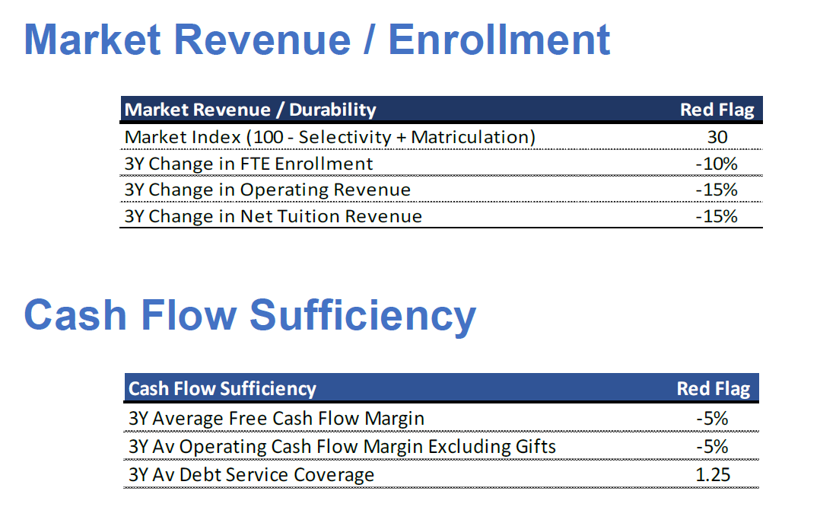
Financial Screenings

Slide 11
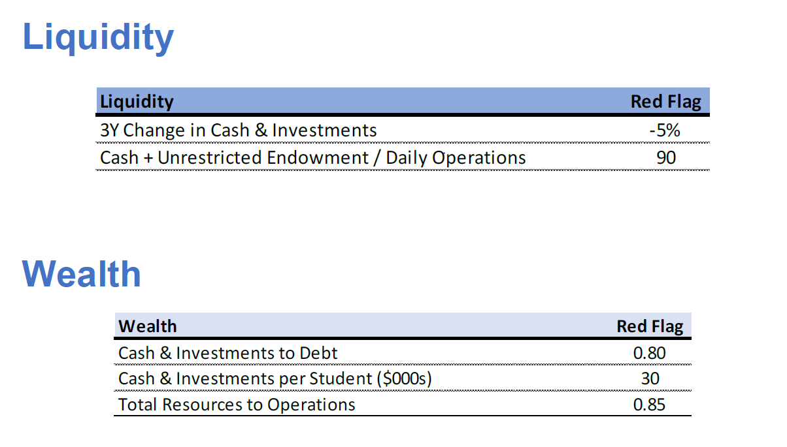
Financial Screenings

Slide 12
Financial Screenings- Observations
NECHE invited Commissioner & Tom to March NECHE meeting and submitted summary results in April.
Process delays between April-June seeking detail and underlying data from NECHE's financial screenings, then pivoting to recreating workbooks and accessing data from IHEs
  FY 22 Response- IHEs now sign a NECHE "Release Form"
Few unique IHEs (e.g., out of state IHEs with MA satellite campus) do no fit well in screening methodology
  FY22 Response- Ongoing analysis; will build upon lessons learned in FY21 to assess the materiality of these distinctions and adapt.

Slide 13
Financial Assessments and Risk Monitoring- Observations
Institutions were responsive, submitted timely risk mitigation plans, through narratives of “plans.”
DHE completed risk assessments in November-December.
  FY22 Response- With the new, DHE-drafted "NECHE release forms;" business processes operationalized; and COVID impacts on enrollment more certain; DHE can complete risk assessments earlier (October).
Risk mitigation plans varied in terms of substance and tone; no prescribed format.
  FY22 Response- IHE Presidents and Trustee chairs will sign Certification attesting IHE has both the means, and willingness (intention) to continue operations through end of next academic year.
Inconsistent back-up documentation submitted with initial Risk Mitigation plans; follow up required by DHE.
  FY22 Response- With new NECHE Release DHE will have the ARFE reports sooner in the process and will be able to ask for specific documentation at earlier stage of Risk Mitigation plan process

Slide 14
Contingency Closure Planning
Phase I (Fall) Contingency | Phase 2 (Spring) Contingency | Final Phase: Closure
Contingency Closure Template Section B.3: Attachment C” (Program Inventory with CIP Codes) | Contingency Closure Template Update Section B.3 with Spring Enrollment Numbers Section C.4: Attachment E (Students receiving VA educational benefits) Section E: “Communications and Records”(Assessment) G2: Community Impact Table list of academic programs, CIP codes, 2-3 potential partners for each program, expected enrollments end of spring semester. Number of students by class year and accumulated credit bands as of the end of Spring semester (0-15, 16-30, etc.) A list of collaborative agreements with other institutions and the corresponding controlling agreements (dual degrees, transfer programs, etc.) | Notice of Closure Template Complete all sections and attachments: Institutional Statement of Closure, Teach-Out Plan and Academic Integrity, Transfer Agreements, Student Data and Student Services, Administration, Communication and Records, Fiscal. Requires extensive back and forth with DHE staff until NOC is deemed sufficient.

Slide 15
Contingency Closure Planning- Observations
In Year 1 initial Contingency Closure Planning began in October with light touch (Phase 1), with Increased requirements and requested revisions/ additions (Phase 2) followed DHE receipt and review of Risk Mitigation Plans.
FY22 Response:
  For IHEs currently in Continued Risk Monitoring: Phase 1 and 2 completed.
  For IHEs newly screened-in: Phase 1 and Phase 2 Contingency Closure Planning are both required before Jan 1, simultaneously with Risk Mitigation Plan submissions.

Slide 16
Overview: MA Law on Annual Financial Assessments- DENA
BHE must establish process to annually assess IHE financial information for “at risk of imminent closure” determination:
    Assessment must include annual screenings;
    Financial screenings may be conducted by accrediting agency (NECHE), pursuant to an MOU.
IHEs must proactively notify BHE of any “known financial liabilities or risks.”
IHEs must annually post audited financial statements.
IHEs must ensure their trustees receive instruction and training, at least once every four years, on fiduciary duty and financial metrics
**Strict Confidentiality - DHE.FARMSubmissions@mass.gov

Slide 17
The Other Legal Requirements-
IHEs must proactively notify BHE of any “known financial liabilities or risks.”
All 85 IHEs received June 29, 2020 Notice from Commissioner with expectations on what/ how to report (confidentially):
  Anticipated problems relating to liquidity or cash deficiencies
  Any significant negative financial event
  Any decision to close any instructional locations
  New or continuing merger/ teach out discussions.
  Any major changes in academic programs
  Any other fiscal or “adverse events” reported to another oversight entity (e.g., accreditor)
FY22 Recommendation- Consider requiring annual “nothing to report” IHE checkbox/confirmation.

Slide 18
The Other Legal Requirements
IHEs must annually post audited financial statements.
  ALL 85 IHEs notified* of requirement and portal reporting process.
  94% of IHEs in full compliance
  No FY22 recommendations at this time.
IHEs must ensure their trustees receive instruction and training, at least once every four years, on fiduciary duty and financial metrics
  All 85 IHEs notified* of requirement and portal reporting process
  DHE worked with TBC/ AGO on comprehensive training offered live (Jan 26th) and now asynchronously (recorded)
  Nov 1, 2021- reporting deadline for trustees in key leadership roles
  No FY22 recommendations at this time.
*DHE Legal Notices- June 29th, December 10th, January 11th (on trustee training).

Slide 19
FY22 Responses, Recommendations and Next Steps

Slide 20
Year 1 Issues ⇨ Year 2 Approaches
DHE Staff Implemented Approaches- SUMMARY
Issues
Internal Management
  Need for accelerated deployment/implementation
  COVID-considerations
NECHE
  Lost time in April-June on NECHE discussion for additional screening info.
  DHE recreated methodology through time-intensive, manual process.
Contingency closure planning
  Prior contingency closure plan template development process too binary.
  Phase 1 Contingency closure info limited to program inventory.
Solutions
Internal Management
  Operationalized business; developed template communications, financial screening workbooks, etc.
NECHE
  IHE “Release Form” developed and implemented for Year 2 to streamline NECHE data transfer
  Data from Salesforce will be in a better format for immediate DHE analysis
Contingency closure planning
  Plan to accelerate contingency closure planning information sought before Jan 1 to include Phase 2 information.

Slide 21
Additional Recommendations
Accelerate the timeline from December to October for “at risk” and public notice determinations
  By October fall enrollment should be known.
  Year 1 provides a baseline “starting point” for analysis
  Communications and workbook templates from Year 1 ready to go
Require all private IHEs Presidents and Board Chairs that are assessed as “at risk” to submit Certifications
  Attesting that they have both the means (18 months) and intention (commitment) to stay open through end of next academic year.
Increase DHE capacity and resources to conduct assessments, risk monitoring and contingency closure planning.
  FARM manager/ analyst position is funded and posted
  Explore procuring, as needed, DHE consultant support for on-site fiscal review, analysis and guidance in contingency closure phase to support an orderly closure.

Slide 22
Next Steps and Key Issues for FY22
FY22 Screenings in progress- DHE Received Year 2 (FY20) NECHE results; conducting assessments.
  Key issue: continue to carefully assess COVID impact, including the impact of short-term stimulus funding on IHE financial stability
June 22 BHE meeting- Discuss recommendations.
Summer 2021- Socialize recommendations with stakeholders; draft amended implementation procedures and regulations, as necessary.
Summer 2021- Hire and onboard new FARM manager/ analyst position.
October 2021 BHE meeting- DHE Report on FY22 work, including screenings/ assessments, and recommendation implementation.

Slide 23
Discussion

Slide 24
External Communications & Guidance
Mass mailings (legal notices from Commissioner):
  June 29, 2020 – Legal Notice of Annual Financial Screenings and Evaluations; Immediate Notification of Known Financial Liabilities and Risks; Posting of Audited Financial Statements; and Required IHE Trustee Training
  December 10, 2020 – Notification of Reporting Portal for Audited Financial Statements; and Require IHE Trustee Training
  January 11, 2021 – Private Higher Education Trustee Training Information
DHE website: https://www.mass.edu/strategic/farm.asp
  Statute, regulations, implementation procedures, notices
DHE Reporting Portal- Trustee training certifications; annual financials.
FARM External Contact for Technical Assistance-
  Alex Nally, Assistant General Counsel

